Slide 1
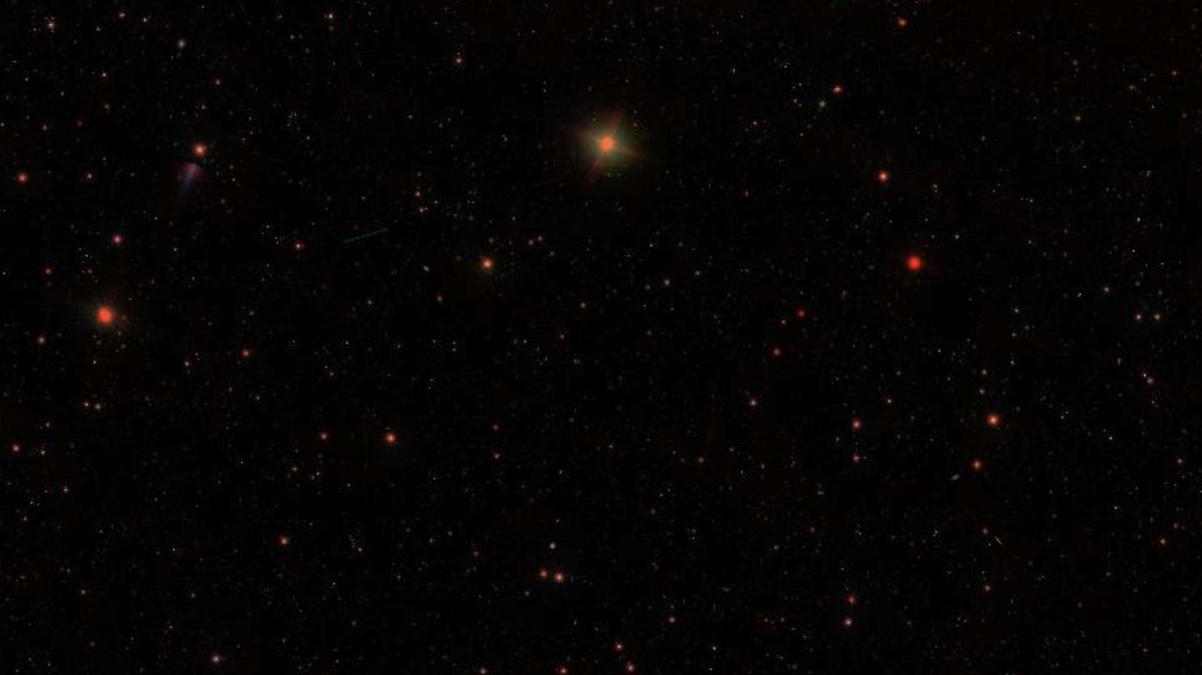
RESULTS
Show original FITS data next to log(N) plot
Show simulated data + object fitting
Show catalogue of objects w/ magnitude and position

Slide 2
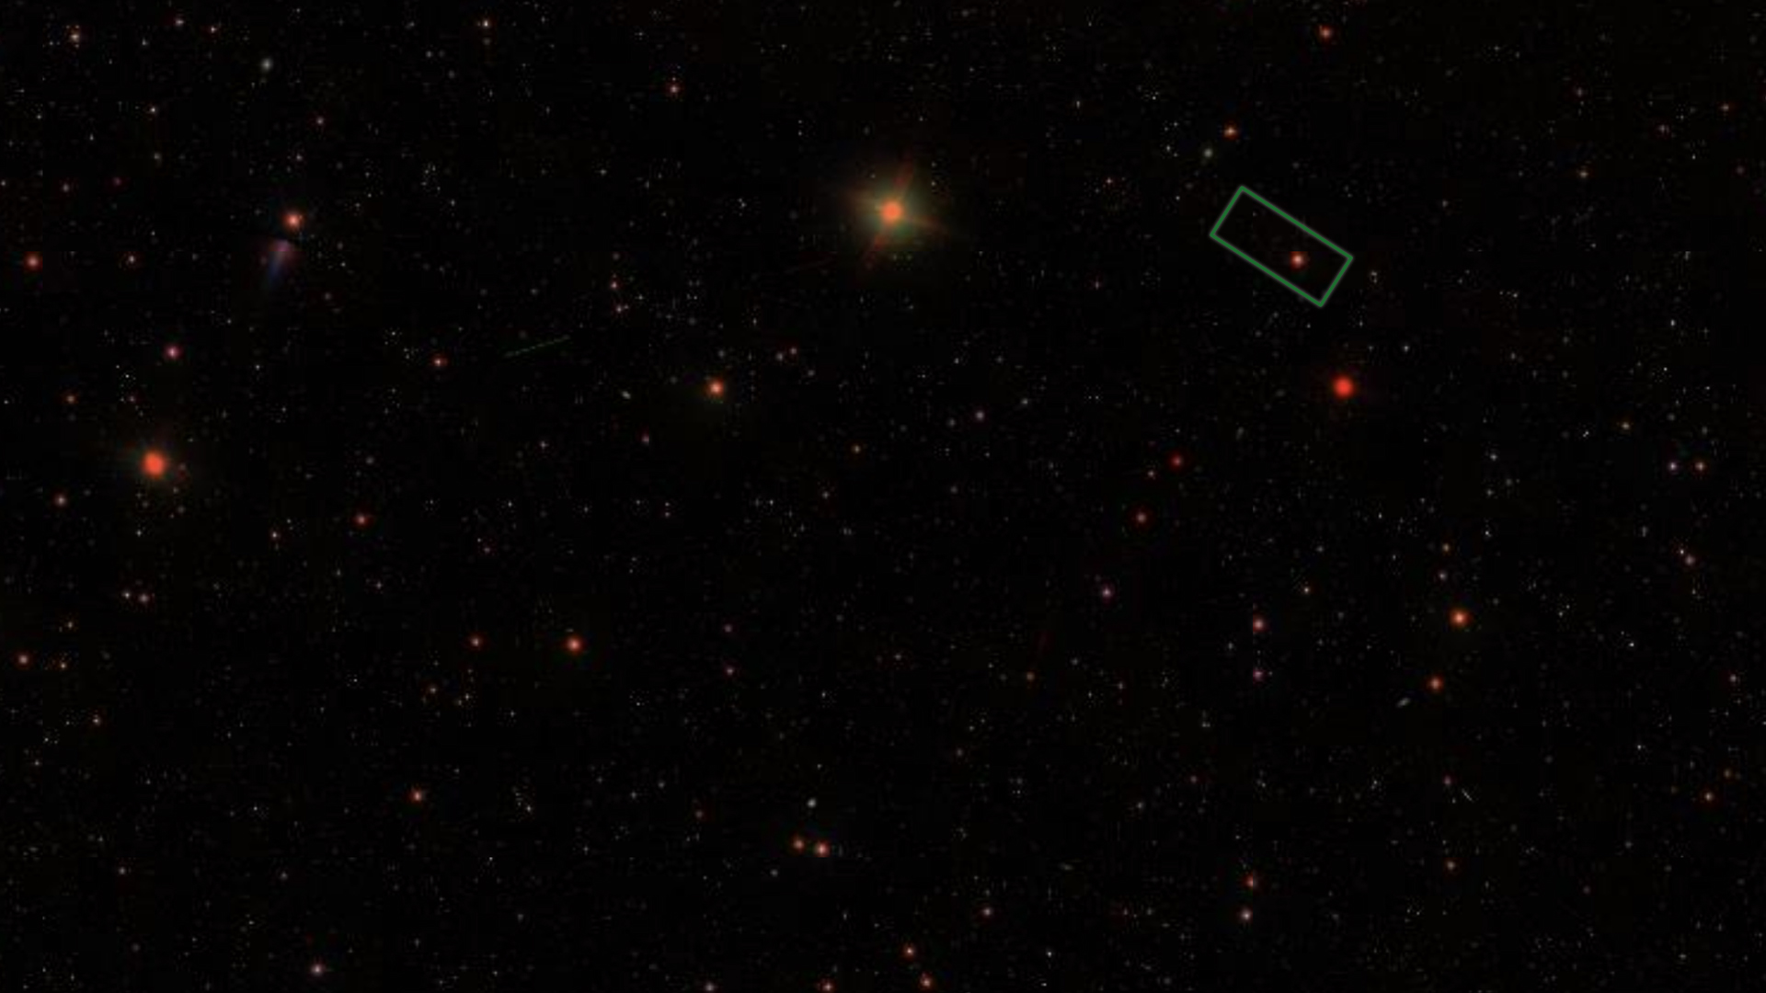
ASTRONOMICAL IMAGE PROCESSING
DAVID BATES & SUKORNO ASAD

Slide 3
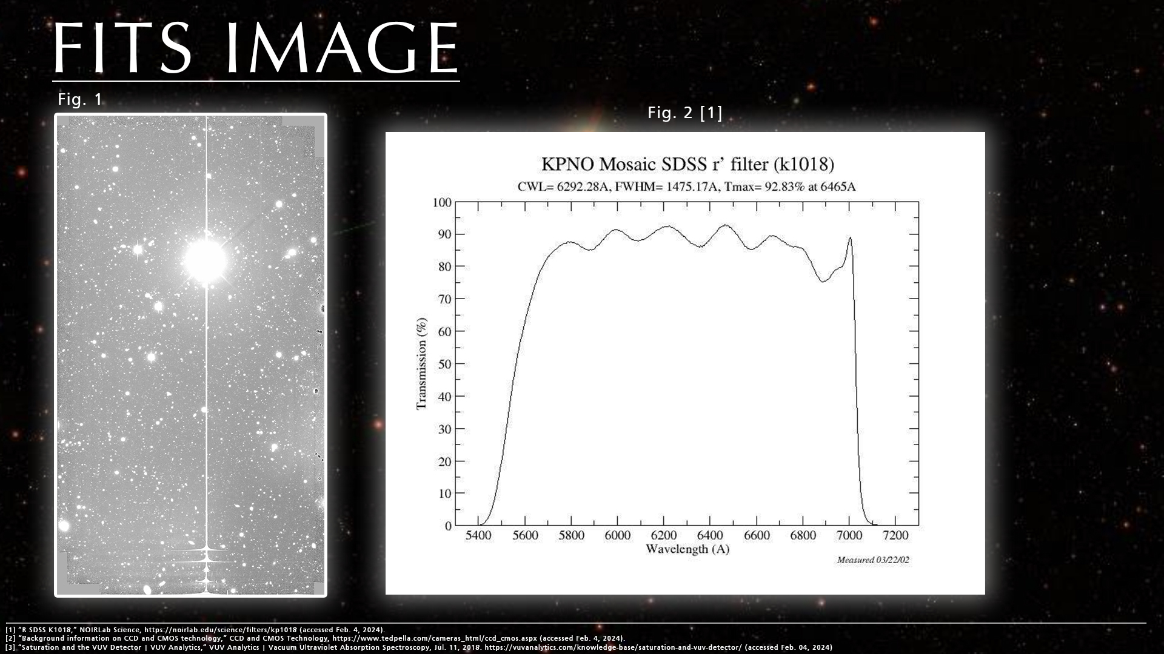

Slide 4
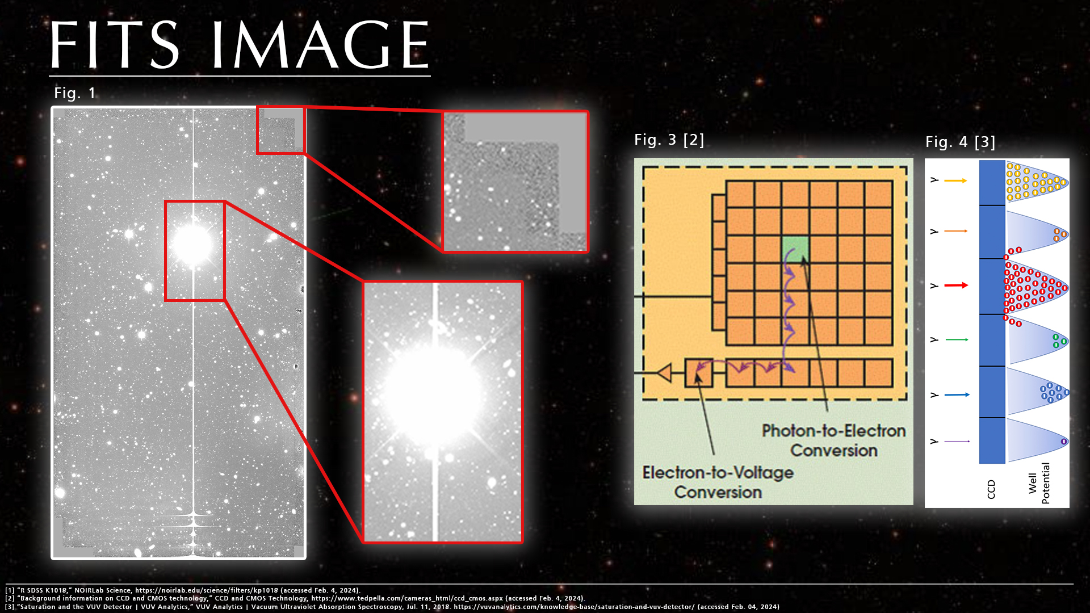

Slide 5
AIMS
Correct for background count
Isolate and label objects
Use pixel count of each object to find magnitude
Store data for each object in a catalogue
Categorise objects into either star or galaxy
Plot log(N) cumulative freq. of object count against magnitude

Slide 6
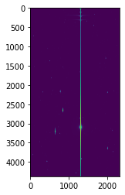
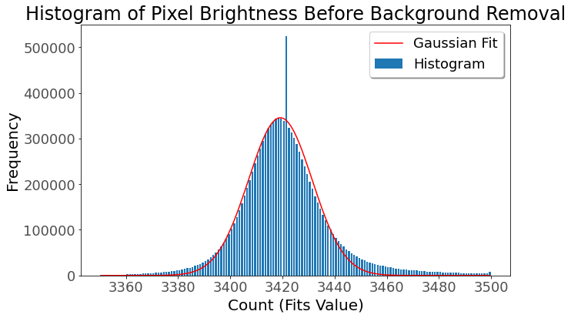
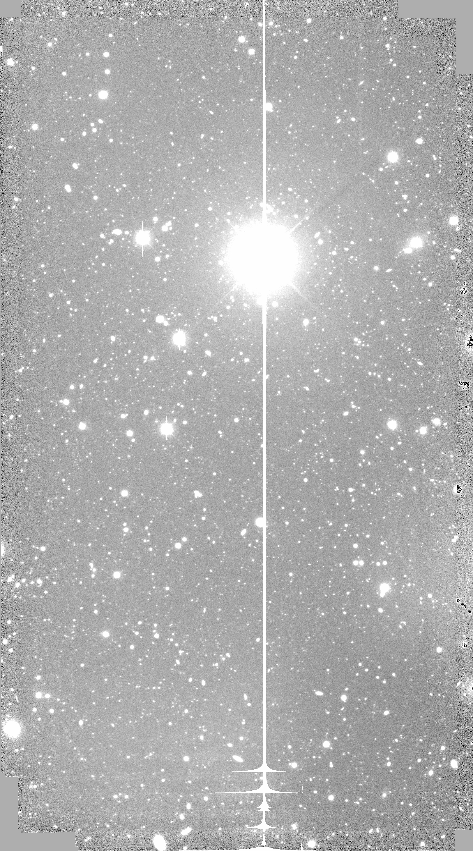
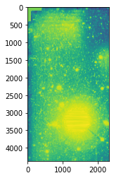
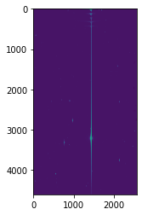
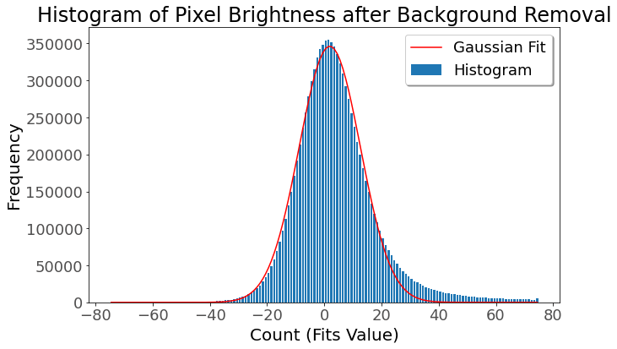
BACKGROUND MASK
Fig. 5 (above) & 6. (below). The distribution of the background count before and after removal. The negative background count below are unphysical but are an artefact of the method. The negative values are part of the background so only positive counts are used for the analysis.
corrected
Fig. 3 & 4. The image to be analysed after background is removed (top) and before (bottom).
Fig. 1. The original image being analysed.
Fig. 2. The background mask applied. The bright region (top) is caused by the main star and other bright regions are brighter in the original image.

Slide 7
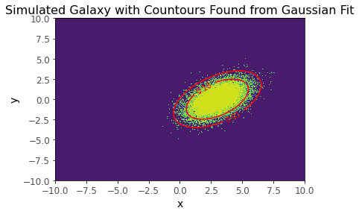
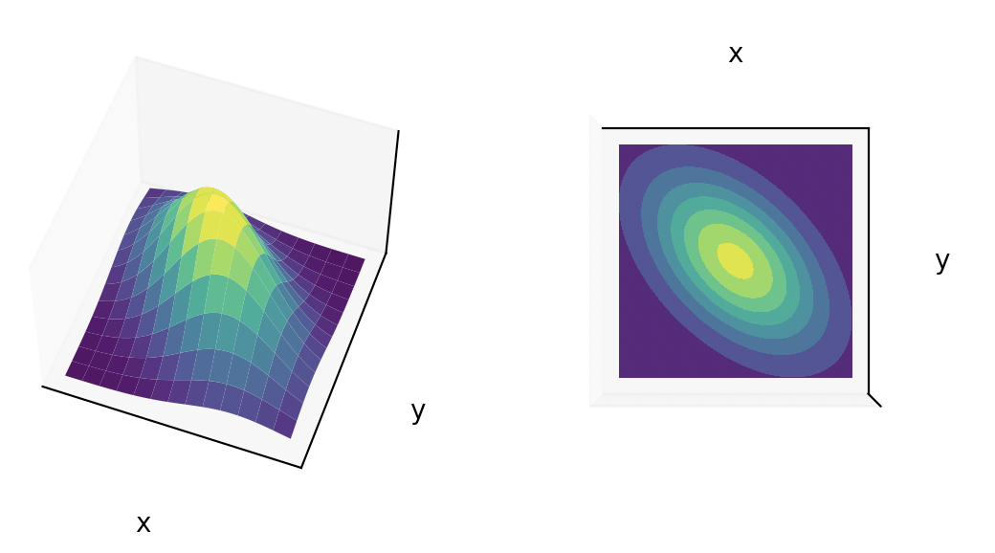
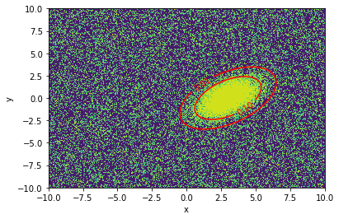
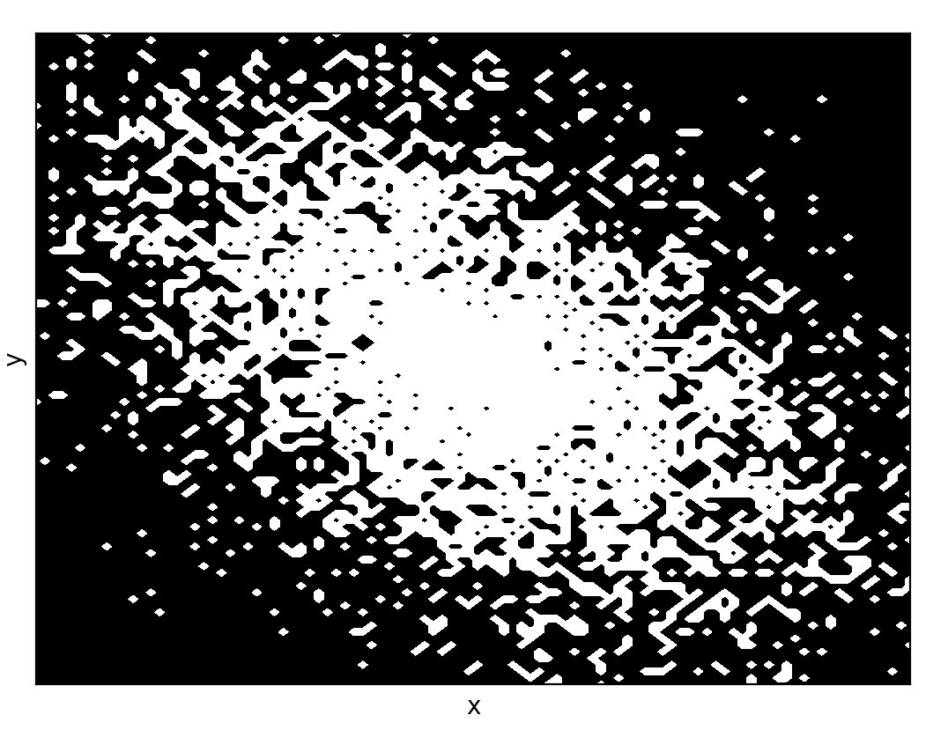
SIMULATED DATA
simulated gaussian
(suk)
multiple galaxies simulated
and fitted

Slide 8
OBJECT CATALOGUE
Index | Class | Num Objects | Avg Magnitude | Total Magnitude | Total Count | Count Error | Size | Centre
 | Star | 1
41 | Cluster | 2 | 24.08 | 8.56 | 41500 | 600 | 910 | (3596,285)
 | Galaxy | 1
galaxy detection

Slide 9
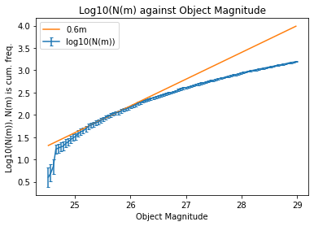
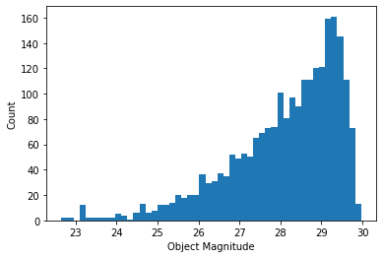
Log(N) Plot
Histogram of Number of Objects against Magnitude
log plot
Histogram
Fig.1. Plot of Log10(N) against object magnitude where N is the cumulative frequency of objects brighter than m. The gradient 0.6m is shown which fits our data but highlights issues with our method compared to the deep-field distribution assumption
Fig.2. Histogram showing the distribution of the magnitude of galaxies used in the cumulative log plot in Fig. 1.

Slide 10
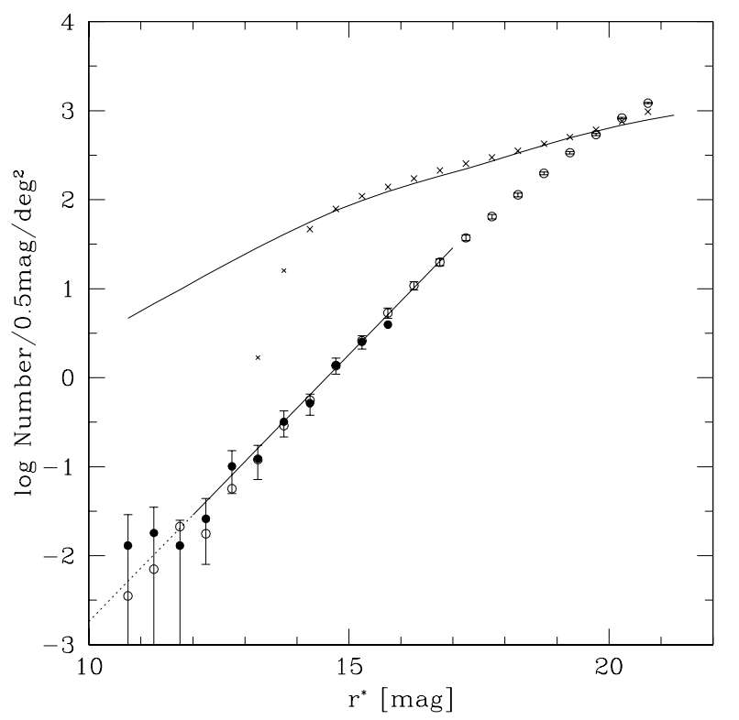
Discussion
disagreements
signs of galaxy evolution:
deceleration q₀
no-evolution models underpredict faint counts
Fig. 1. Mosaic 1.1 KPNO R-band data [4]
[4] Yasuda, N., et al. "Galaxy number counts from the Sloan Digital Sky Survey commissioning data," in The Astronomical Journal, vol. 122, no. 3, pp. 1104, 2001.
[5] “Durham Physics Cosmology Research Galaxy Counts,” star-www.dur.ac.uk. http://star-www.dur.ac.uk/~nm/pubhtml/counts/counts.html (Accessed Feb. 04, 2024)
[6] Metcalfe, N., et al. "Galaxy formation at high redshifts," in Nature, vol. 383, no. 6597, pp. 236–239, 1996. ‌

Slide 11
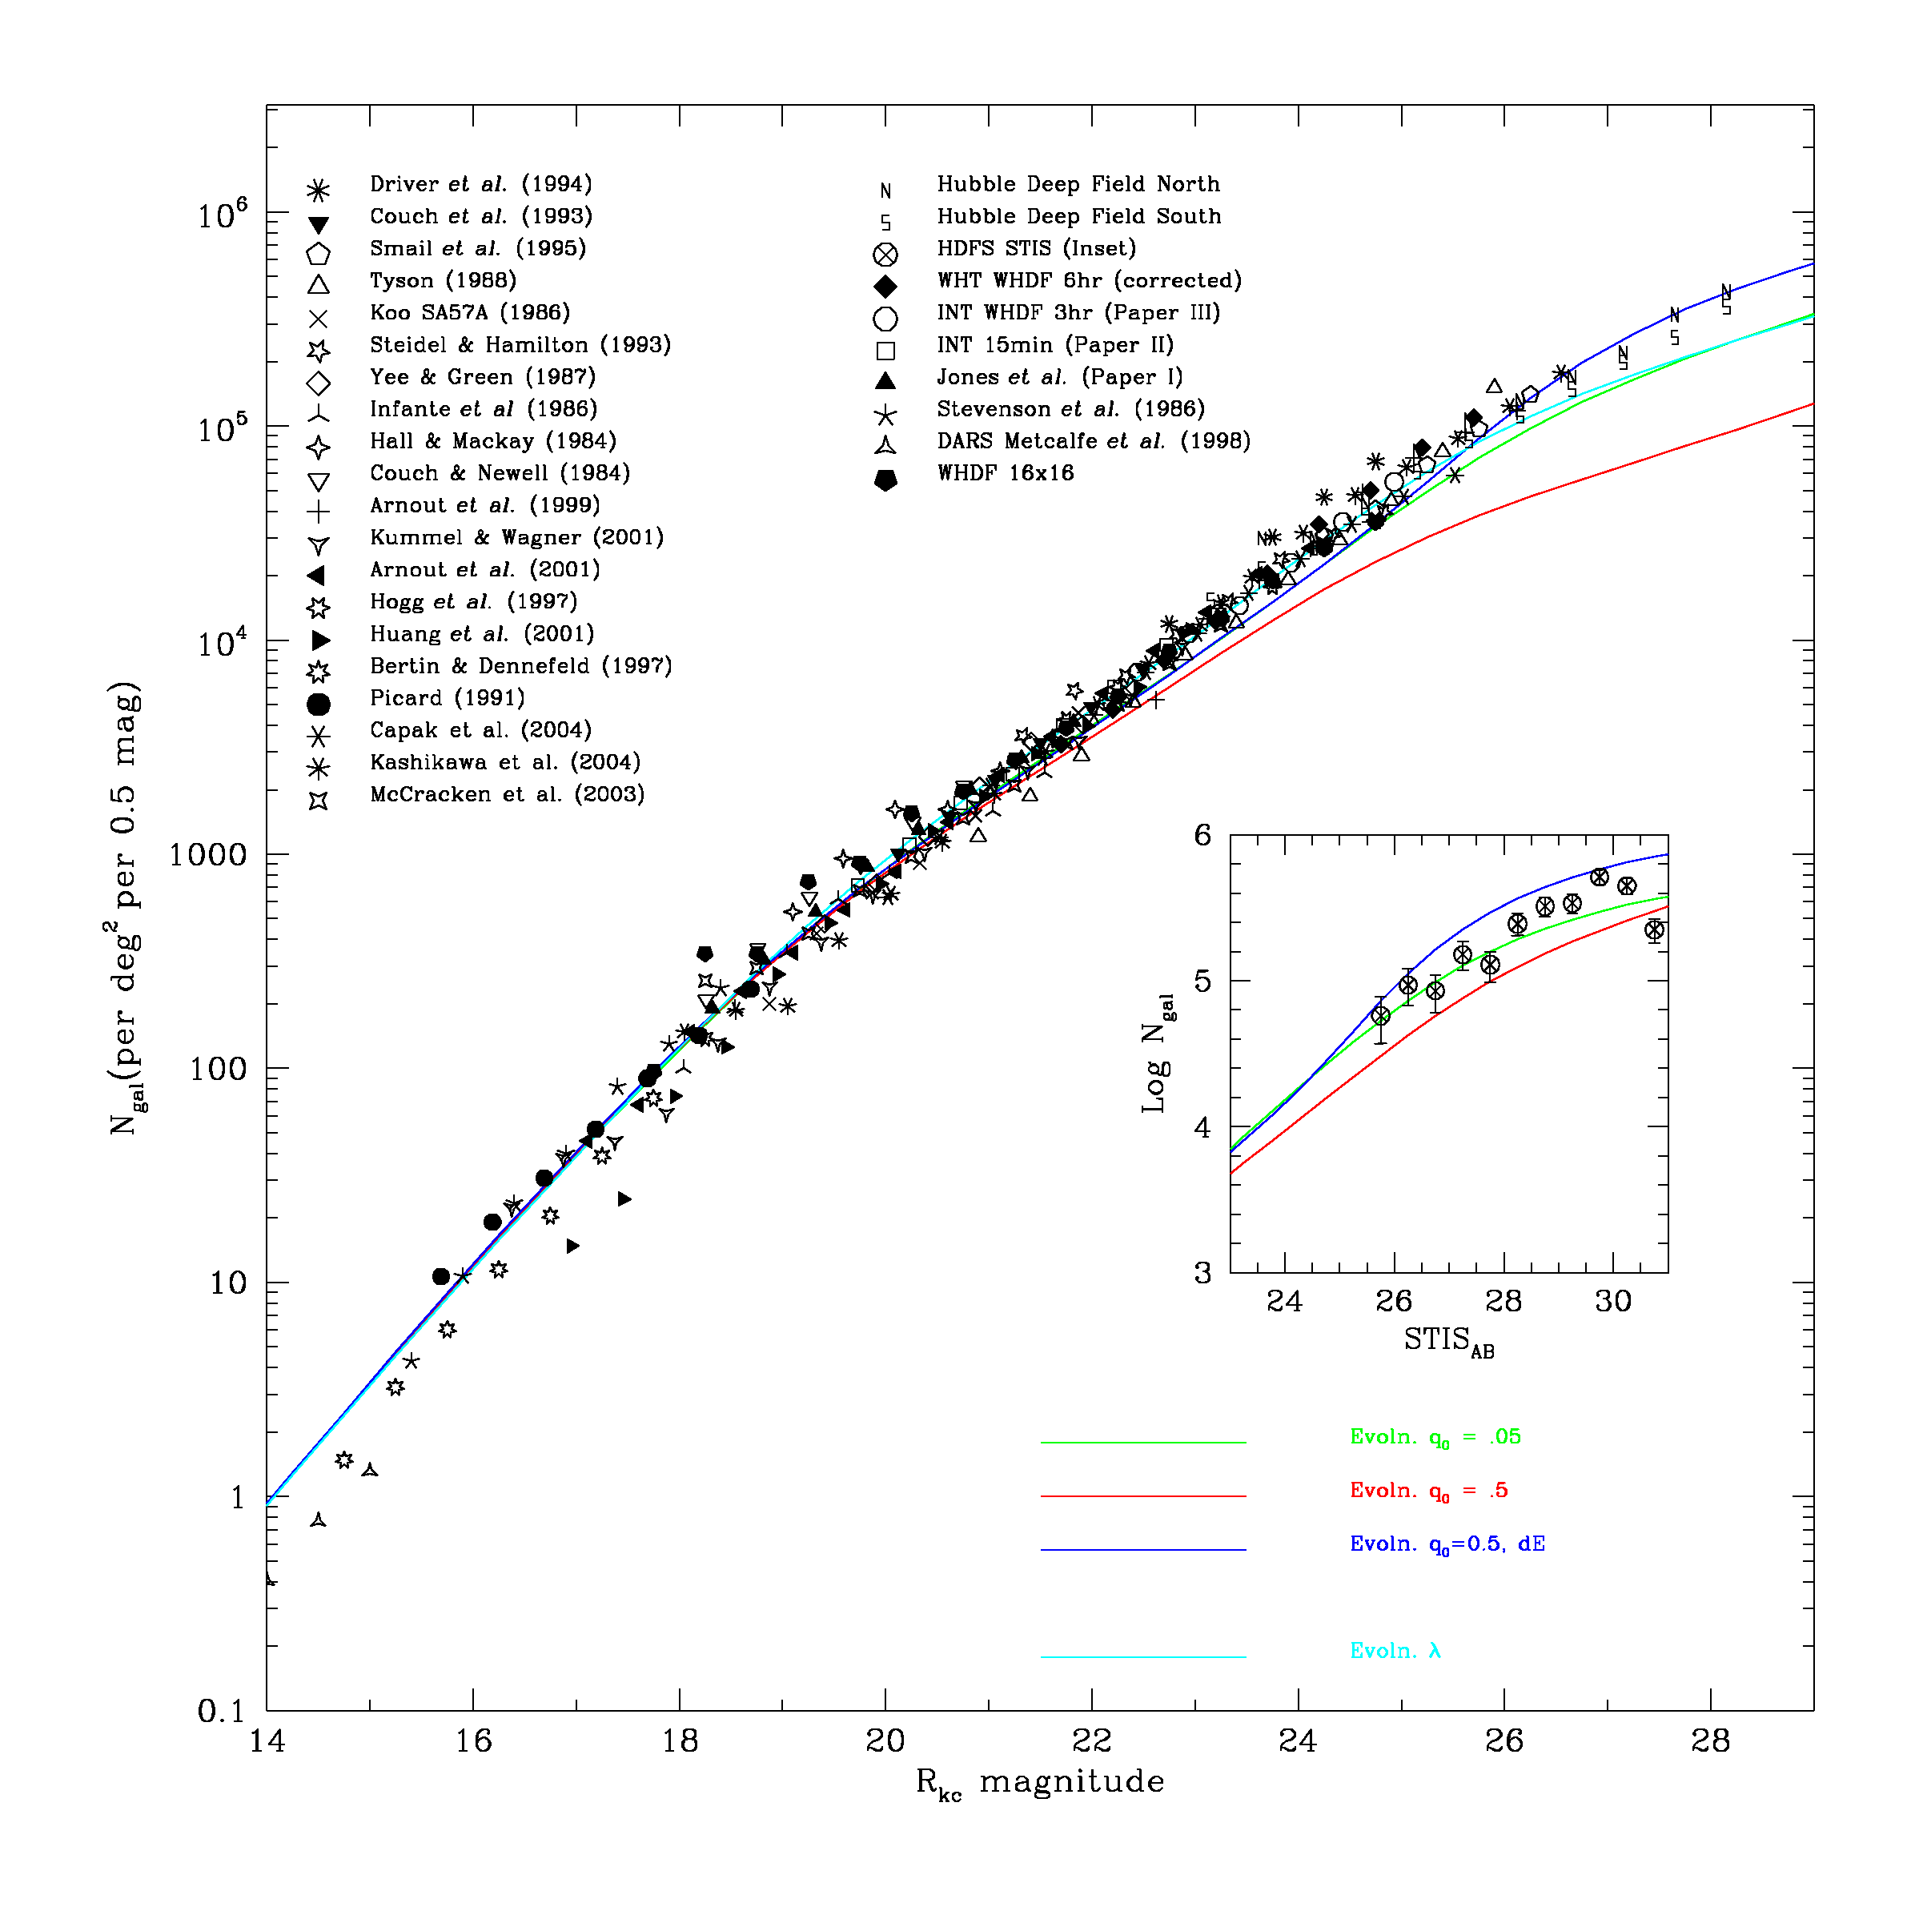
Discussion
disagreements
signs of galaxy evolution:
deceleration q₀
no-evolution models underpredict faint counts
Fig. 1. Compilation of R-band data from different sources [5]
[4] Yasuda, N., et al. "Galaxy number counts from the Sloan Digital Sky Survey commissioning data," in The Astronomical Journal, vol. 122, no. 3, pp. 1104, 2001.
[5] “Durham Physics Cosmology Research Galaxy Counts,” star-www.dur.ac.uk. http://star-www.dur.ac.uk/~nm/pubhtml/counts/counts.html (Accessed Feb. 04, 2024)
[6] Metcalfe, N., et al. "Galaxy formation at high redshifts," in Nature, vol. 383, no. 6597, pp. 236–239, 1996. ‌

Slide 12
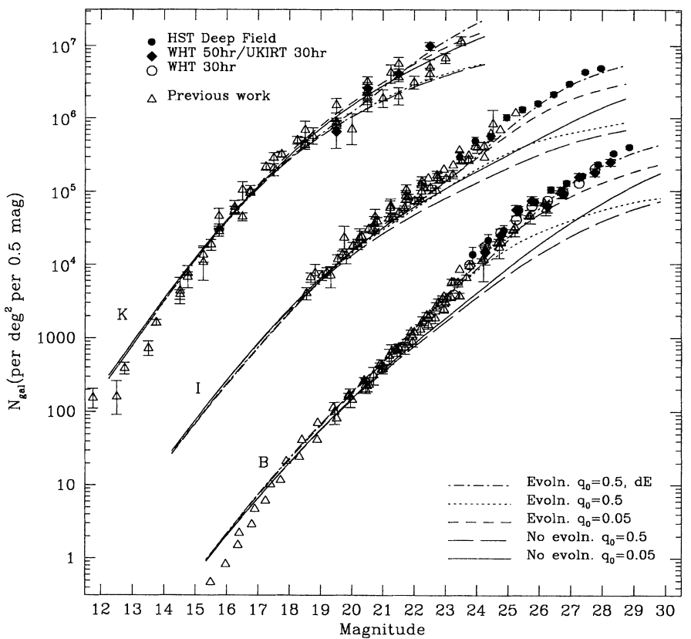
Discussion
disagreements
signs of galaxy evolution:
deceleration q₀
no-evolution models underpredict faint counts
Fig. 1. Comparisons to different cosmological models based on q₀
[4] Yasuda, N., et al. "Galaxy number counts from the Sloan Digital Sky Survey commissioning data," in The Astronomical Journal, vol. 122, no. 3, pp. 1104, 2001.
[5] “Durham Physics Cosmology Research Galaxy Counts,” star-www.dur.ac.uk. http://star-www.dur.ac.uk/~nm/pubhtml/counts/counts.html (Accessed Feb. 04, 2024)
[6] Metcalfe, N., et al. "Galaxy formation at high redshifts," in Nature, vol. 383, no. 6597, pp. 236–239, 1996. ‌

Slide 13
THANK YOU FOR LISTENING

